Slide 1
Sell Your Skills
Getting the job
Notes:
Instructor:
Read through the whole lesson (including all the notes) before the day of class
Make note of and gather any supplies you need to bring
Prepare examples, stories
Think through how much time you want to spend on individual activities; make notes
Be sure to allow time to announce the assignment at the end
Overview:
Intro (slides 1-4): 4-6 minutes
Resumes (slides 5-36): 20-25 minutes
Cover letters (slides 37-47): about 10 minutes
Interviews (slides 48-56): about 10 minutes
Wrap-up (slides 57-61): 1-2 minutes
(You’ll notice that if you spent the maximum suggested time in each section, you’d go over 50 minutes)

Slide 2
Review
Get Noticed
Learn to value and sell your strengths
Practice STAR (interviewing)
Consider the importance and utility of networking (STEM Fair)
Notes:
Ask: What did we go over last class?
Before coming to class, students should complete the following:
Visit the STEM fair and talk with at least 3 recruiters
Sell your strengths in STAR format
Learn about what they do
Evaluate your pitch, make it better
Bring 2 copies of your updated résumé to class (if you don’t have a résumé, look up basic résumé formatting online and bring something to class)

Slide 3
Reflect
Write about your experience at the STEM Fair.
How was it?
What did you do well? Poorly?
What can you work on? What is already good?
Notes:
Spend 3-5 minutes writing
Spend a couple minutes sharing in pairs
If the STEM Fair hasn’t happened yet, skip this activity.

Slide 4
Today
Objectives:
Discuss the value of résumés & cover letters in selling your skills (HW)
Apply STAR principles in your cover letter
Practice initiating networking conversations
Notes:
Resumes: 20-25 minutes
Cover letters: about 10 minutes
Interviews: about 10 minutes

Slide 5
Résumés
Notes:
Resumes (slides 5-36): 20-25 minutes
Cover letters (slides 37-47): about 10 minutes
Interviews (slides 48-56): about 10 minutes
Wrap-up (slides 57-61): 1-2 minutes

Slide 6
Question
“Why should I hire you? What makes you different from the other applicants?”
Notes:
Instructor: “Think of the questions you answered before last class: “Why should I hire you? What makes you different from the other applicants?”
Share your answer to this question with a partner
Has your answer changed since you wrote it down last week?
How did attending the STEM fair change your answer?
Image from youtube.com

Slide 7
Your Résumé
The résumé is the go-to way to show why people ought to hire you
It’s the first impression – essentially, “this is me on one page”
This can catapult your career – into a wall, or over it
Notes:
Image from http://thinkforfitness.com/wp-content/uploads/2012/06/Hitting-the-Wall.png

Slide 8

Resume Stats
For every person hired:
250 people send resumes
4 to 6 people are interviewed
Notes:
“On average, every corporate job opening attracts 250 resumes”
A little healthy competition, anyone?
“Only 4 to 6 of these people will be called for an interview, and only 1 of those will be offered a job.”
What about the 244-246 other people?
One possible reason: a festeringly-bad resume (or, maybe, just an “average” one)
Let’s make yours . . . not that
Source: http://www.inc.com/peter-economy/19-interesting-hiring-statistics-you-should-know.html
Image from pixabay.com

Slide 9

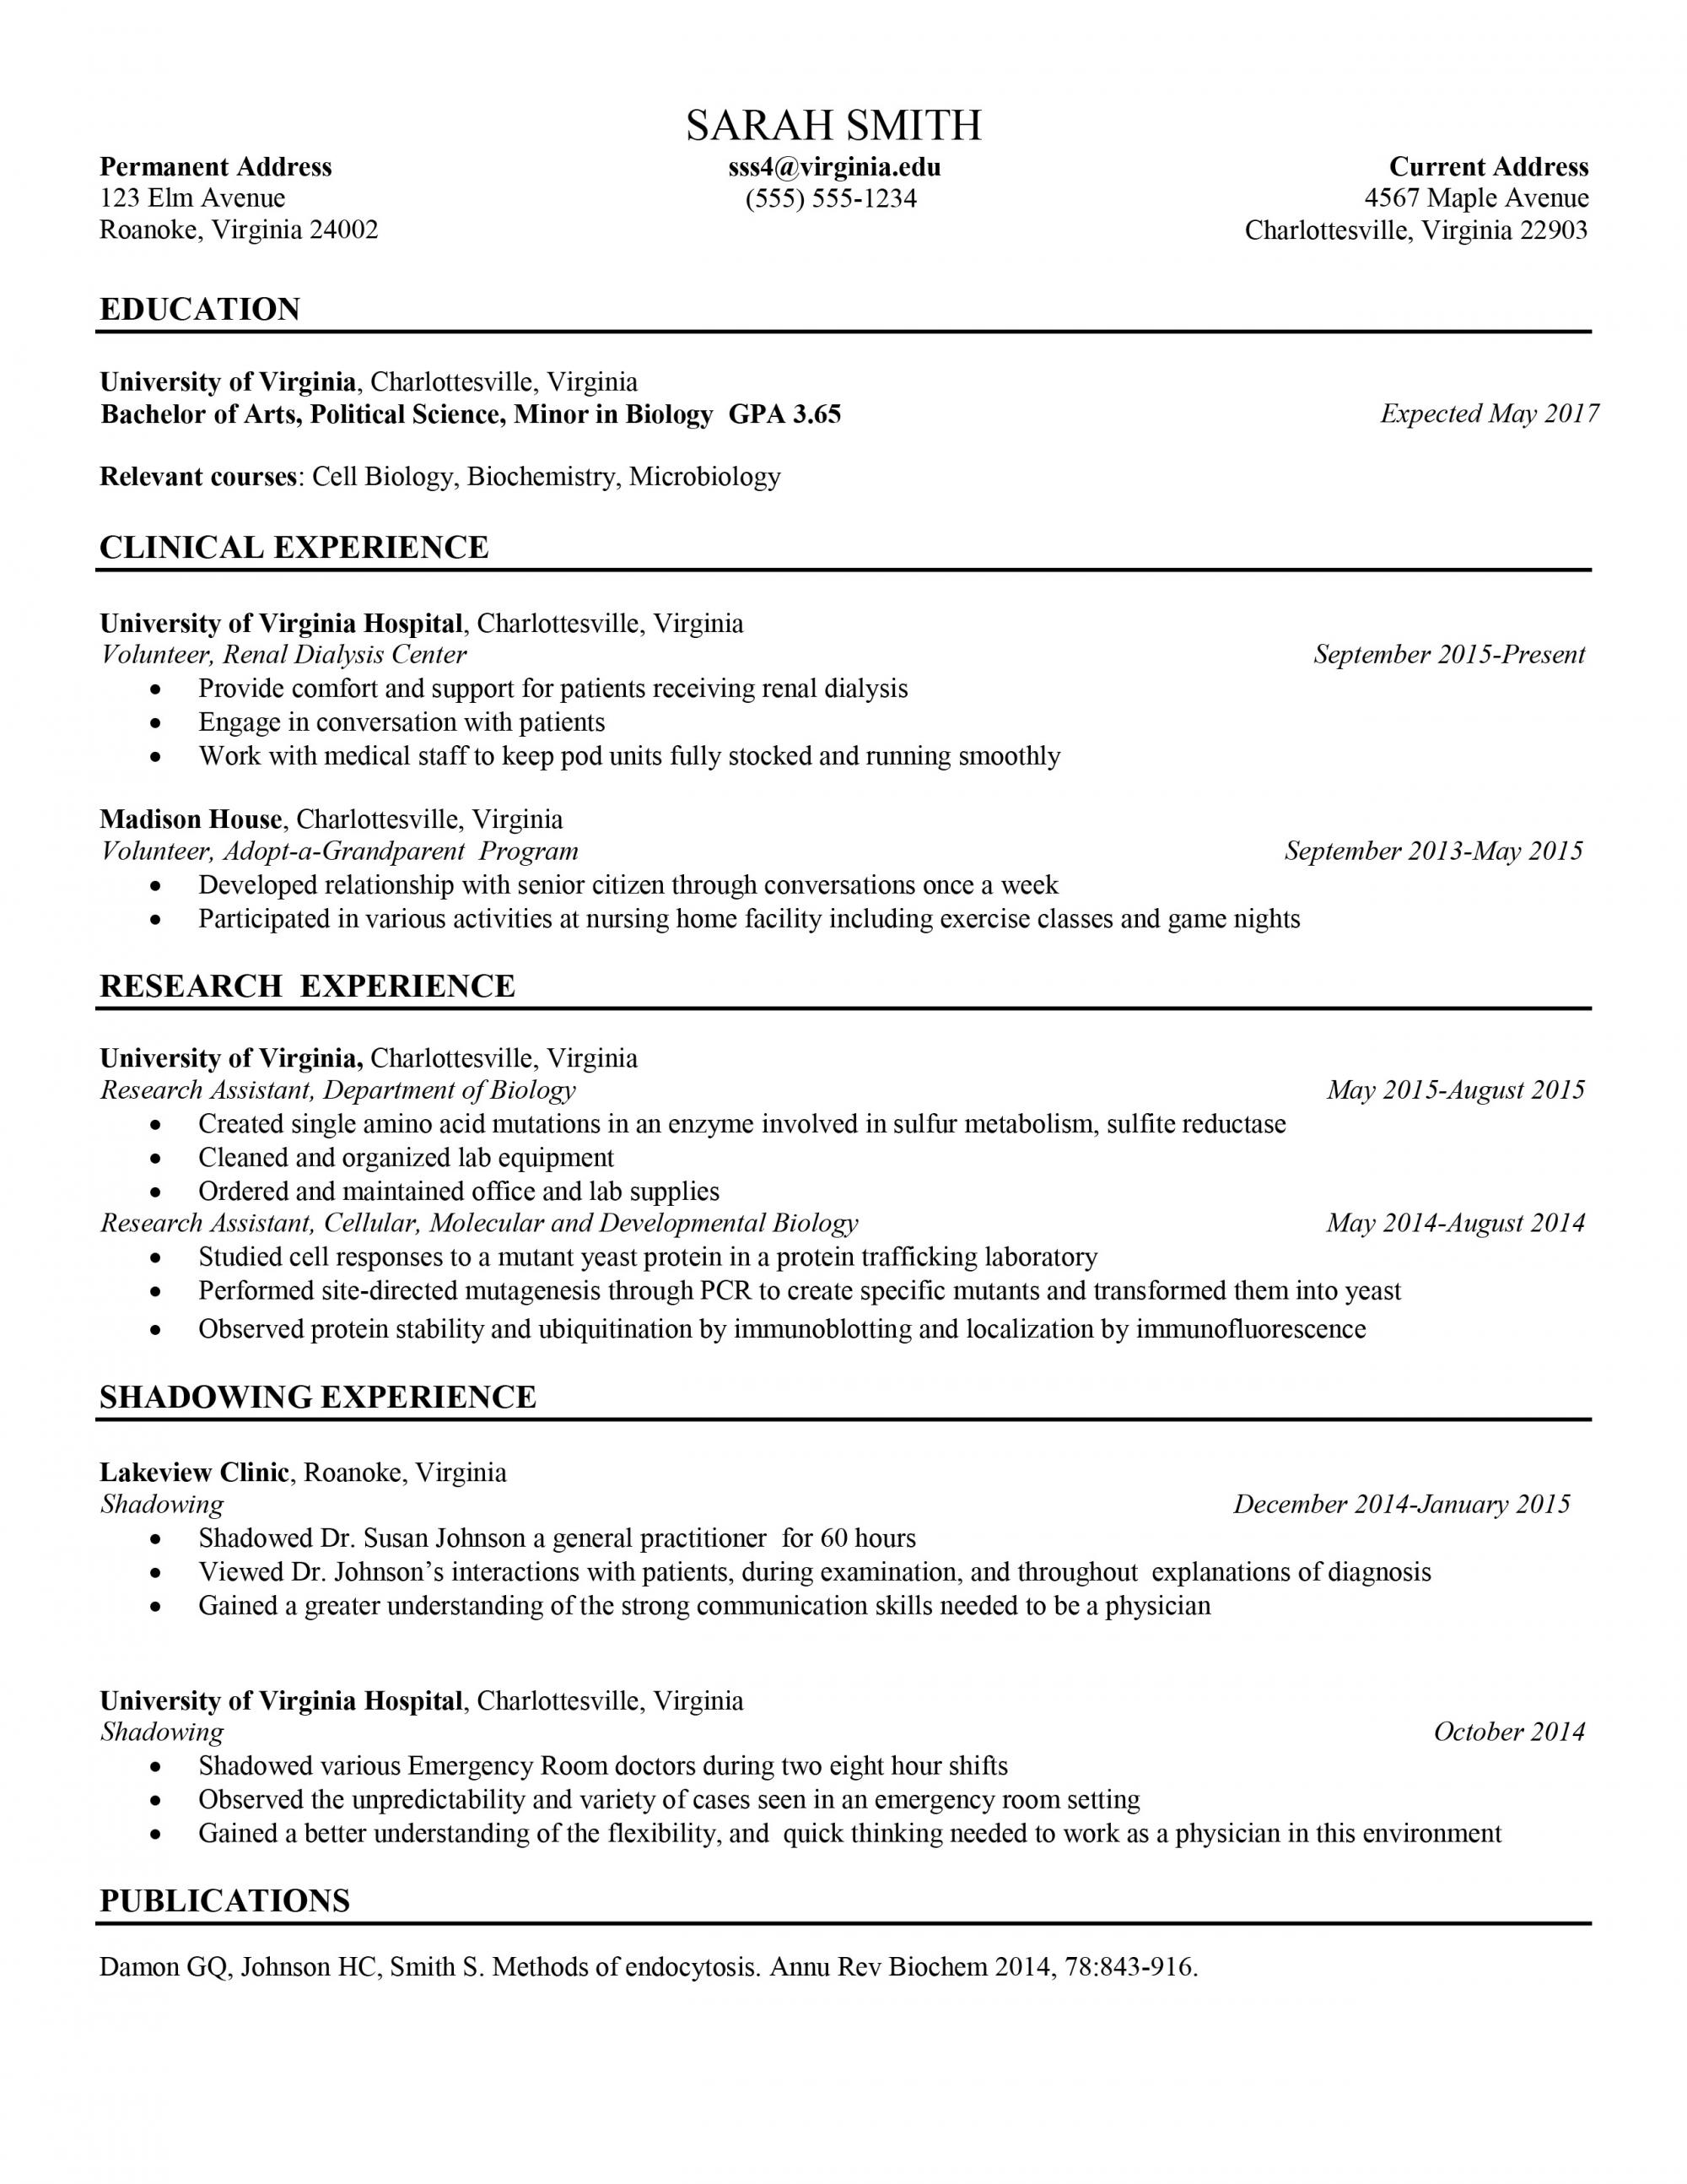
Activity: Whose Résumé Reigns Supreme?
1. Take out 1 copy of your resume
2. Place your résumé on a whiteboard or table
3. Assign points to the résumé(s) of your choice,
You can assign them however you wish (e.g., 1 point for Eric’s, 2 for Jill’s; all 3 for Bob’s; etc.).
Criteria for voting:
1. Aesthetics
2. Content
3. Usability
Notes:
Introduction: “We’re going to be sharing our resumes so that we can see what works and get a few ideas for future revisions.”
-Read instruction\s aloud
-Explain how students will award points (using tokens? Written on the board next to each resume?)
-Be sure to emphasize that this is meant as an opportunity to see what works about resumes – and not to harshly criticize them.
You could say, “Approach this activity with tact and open-mindedness, and it will be informative and constructive.”
-Tell students to leave resumes at the front of class after the activity is completed.
-Most points wins bragging rights for the week (or optional prize).
Optional:
-Bring magnets if you have them, to put resumes on the board. If not, arrange them in rows on a table.
-Bring 3 tokens (or stickers or pennies) for each class member to award as points
-Bring a prize for the winner
-If students haven’t brought their resumes, or you don’t think they’re ready to share, you could use example resumes in slides 10-24
Time: about 5-8 minutes to judge and discuss (next slide)

Slide 10
Reflection
Who won and why?
Based on what you just saw, what are some “best practices” when it comes to résumés?
Notes:
Ask: Who won? (Congratulate the winner)
Why did _________ win? (be specific – actually use the piece of paper; maybe consider passing it around again)
Write “best practices” on the board

Slide 11

Notes:
Image from flickr.com

Slide 12
Expert advice
Use headings
Education
Work Experience
Honors and Achievements
Notes:
The headings are just examples
Source
http://career.virginia.edu/resumes/creating-your-resume/formatting-your-resume

Slide 13

Expert advice
List the most relevant section first (Education or Work Experience)
List your most significant job duties first, starting each line with a strong verb
Notes:
Source
http://career.virginia.edu/resumes/creating-your-resume/formatting-your-resume

Slide 14
Expert advice
Use one font type (or maybe 2)
Use bold, italics, bullets, and spacing to make information accessible
Notes:
No more than 2 font types (e.g., Helvetica for headings and Garamond for everything else)
Source
http://career.virginia.edu/resumes/creating-your-resume/formatting-your-resume

Slide 15
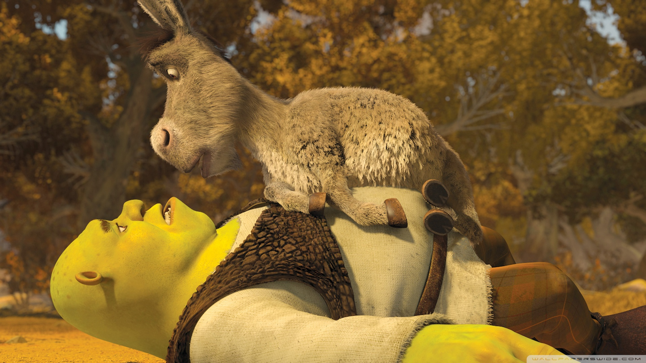
But wait…there’s more!
Résumés have layers.
Résumés should be:
Good-looking
Tailor-made
Notes:
Resumes are much more than the information on them – they have layers, like . . . people from Minnesota in December.
Resumes also need to be:
Good-looking
Tailor-made
Picture source (open source-enabled): https://farm8.staticflickr.com/7607/16909544628_8260dcb7a8_o_d.jpg

Slide 16


Looking Good?
Readers spend an average of 10-30 seconds per résumé.
Imagine you’re a prospective employer with a stack of résumés.
Notes:
Click through the next 15 slides quickly (5-10 seconds each).
You could ask students to judge each resume with a thumbs up or thumbs down. We’re going for first impressions.
Note: It’s hard to imagine a position for which all of these applications would be relevant—they’re from several disciplines—we’re judging them solely on appearance right now
Source: Christianson, L. (2012). Composition training and career services. Presentation to BYU Faculty.

Slide 17

Notes:
Source: Christianson, L. (2012). Composition training and career services. Presentation to BYU Faculty.
Note: names and contact info are intentionally not showing on the slide

Slide 18
Notes:
From http://www.wikihow.com/Sample/Chronological-Resume

Slide 19
Notes:
Source: Christianson, L. (2012). Composition training and career services. Presentation to BYU Faculty.

Slide 20
Notes:
Source: Christianson, L. (2012). Composition training and career services. Presentation to BYU Faculty.

Slide 21
Notes:
Source: Christianson, L. (2012). Composition training and career services. Presentation to BYU Faculty.

Slide 22
Notes:
From S. Mason files

Slide 23
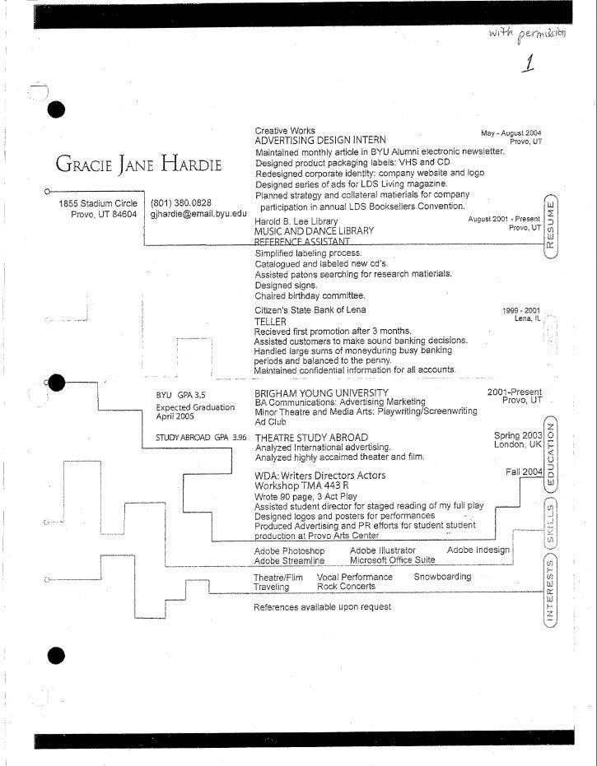
Notes:
Source: Christianson, L. (2012). Composition training and career services. Presentation to BYU Faculty.

Slide 24
Notes:
Source: Christianson, L. (2012). Composition training and career services. Presentation to BYU Faculty.

Slide 25
Notes:
Source: Christianson, L. (2012). Composition training and career services. Presentation to BYU Faculty.

Slide 26
Notes:
From S. Mason files

Slide 27
Notes:
Source: Christianson, L. (2012). Composition training and career services. Presentation to BYU Faculty.

Slide 28
Notes:
Source: Christianson, L. (2012). Composition training and career services. Presentation to BYU Faculty.

Slide 29
Notes:
Source: Christianson, L. (2012). Composition training and career services. Presentation to BYU Faculty.

Slide 30
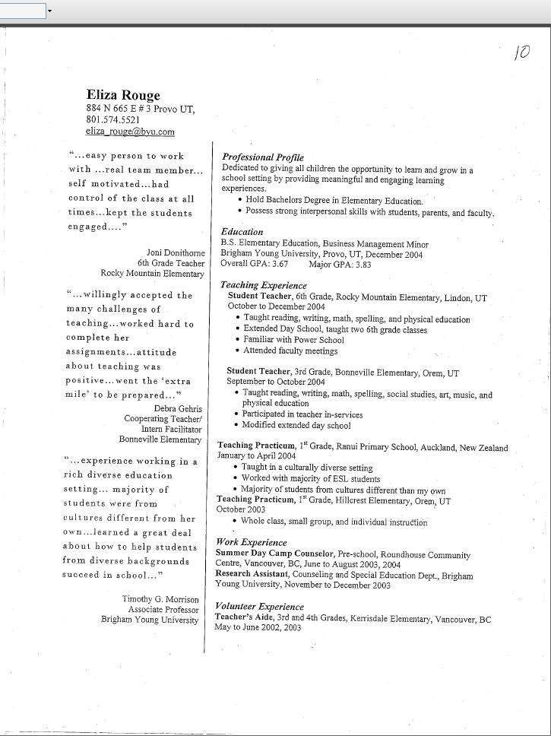
Notes:
Source: Christianson, L. (2012). Composition training and career services. Presentation to BYU Faculty.

Slide 31
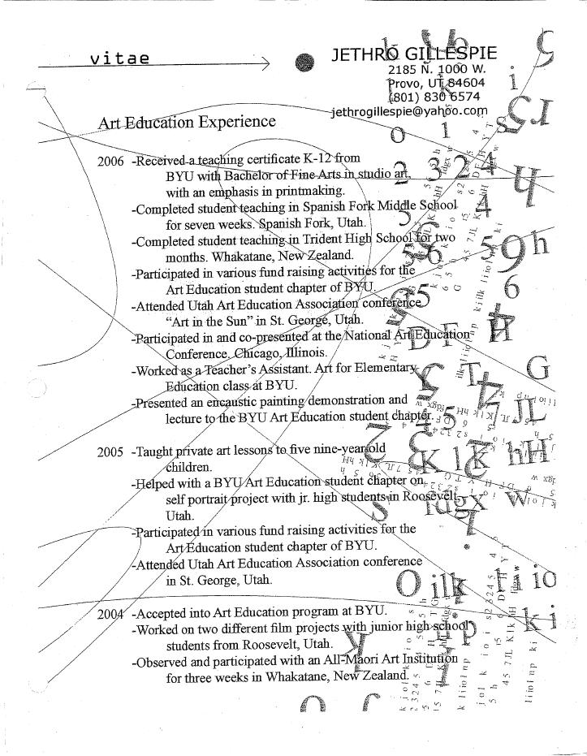
Notes:
Source: Christianson, L. (2012). Composition training and career services. Presentation to BYU Faculty.

Slide 32

Looking Good?
Which résumés you would throw out?
Did any of the résumés stand out (in a good way)?
Notes:
Most of the resumes aren’t very good. You may want to revisit a few, but don’t spend too long.
Best in the bunch: 17, 28, 29
Worst (arguably): 19, 21, 24, 25
Strangest (could be interesting or awful, depending on audience): 23, 30, 31
Image from gratisography.com

Slide 33

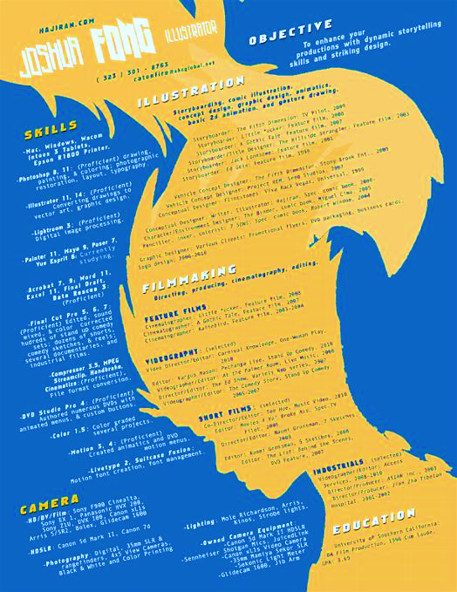
Looking Good?
Take-away: Your résumé represents you.
For the fields you’re entering, simplicity is likely your best option.
Notes:
There is some debate as to how a résumé “should” look.
Basically it boils down to these questions:
What industry are you entering?
What values does this industry support most?
For example, someone in the graphic design business wants to show their graphic design skills, and so their format might be a bit “artsy” to showcase their skills
Take-away: for you (ACME students), simplicity is likely your best option
Images from
lanjut.hol.es
Unsplash.com

Slide 34
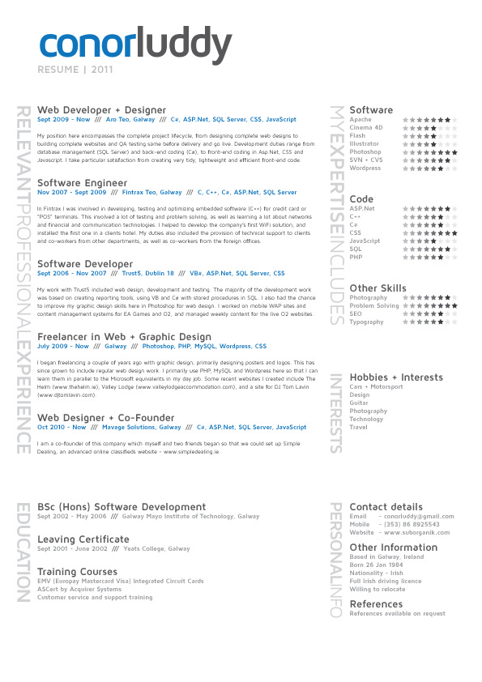
Tailor made?
Quick activity: Look at your résumé. Which industry and jobs does it target?
Take-away: keep your résumé updated and focused on the job you’re applying for.
Notes:
Usually a résumé doesn’t include all of your experiences—a résumé should be “crafted” toward the job you’re applying for – include the jobs and activities most relevant to the job for which you’re applying
(The one exception to this is a CV [curriculum vitae], which contains all your work, research, awards, publications, etc. – more widely used in academia)
Quick activity: Look at your résumé. Which industry and which jobs does it target?
Does it need to be adjusted? Is it right on? Do you have something to add?
Take-away: keep your résumé updated and focused on the job you’re applying for
Image from flickr.com

Slide 35

Activity
Identify a few things that look solid (what did you do well?)
Identify a few places that need work (why do they need work? What’s the fix?)
Brainstorm: what is this résumé missing?
Notes:
Instructor:
“Pull out the other copy of your résumé that you brought to class, and a red pen/pencil (or edit it on your laptop/tablet, if you want – whatever works)”
(other instructions are on the slide)
3-5 minutes
On the next slide, we discuss the same three points (could combine activity with discussion)

Slide 36
Discuss
What did you notice about your résumé that you liked?
What needs to change?
What is your résumé missing?
Notes:
Group discussion based on the activity on the last slide
(3-5 minutes)
Image from www.ducere.edu.au

Slide 37
Cover Letters
Notes:
Cover letters (slides 37-47): about 10 minutes
Interviews (slides 48-56): about 10 minutes
Wrap-up (slides 57-61): 1-2 minutes

Slide 38
Cover Letters
The cover letter introduces your résumé
Be simple and straightforward, clear and concise
Know your audience – research them and write directly to them
Proofread thoroughly. Nothing says’ “Im styupid” like; a grammar issue,.
Notes:
(full script):
The cover letter is an extension of your résumé in which you state your intent to apply for a job and summarize why you are specifically qualified for it.
The strategy for these is much the same as for résumés:
Be simple and straightforward, clear and concise
Know your audience – research them and write directly to them
Proofread thoroughly. Nothing says’ “Im styupid” like; a grammar issue,.

Slide 39
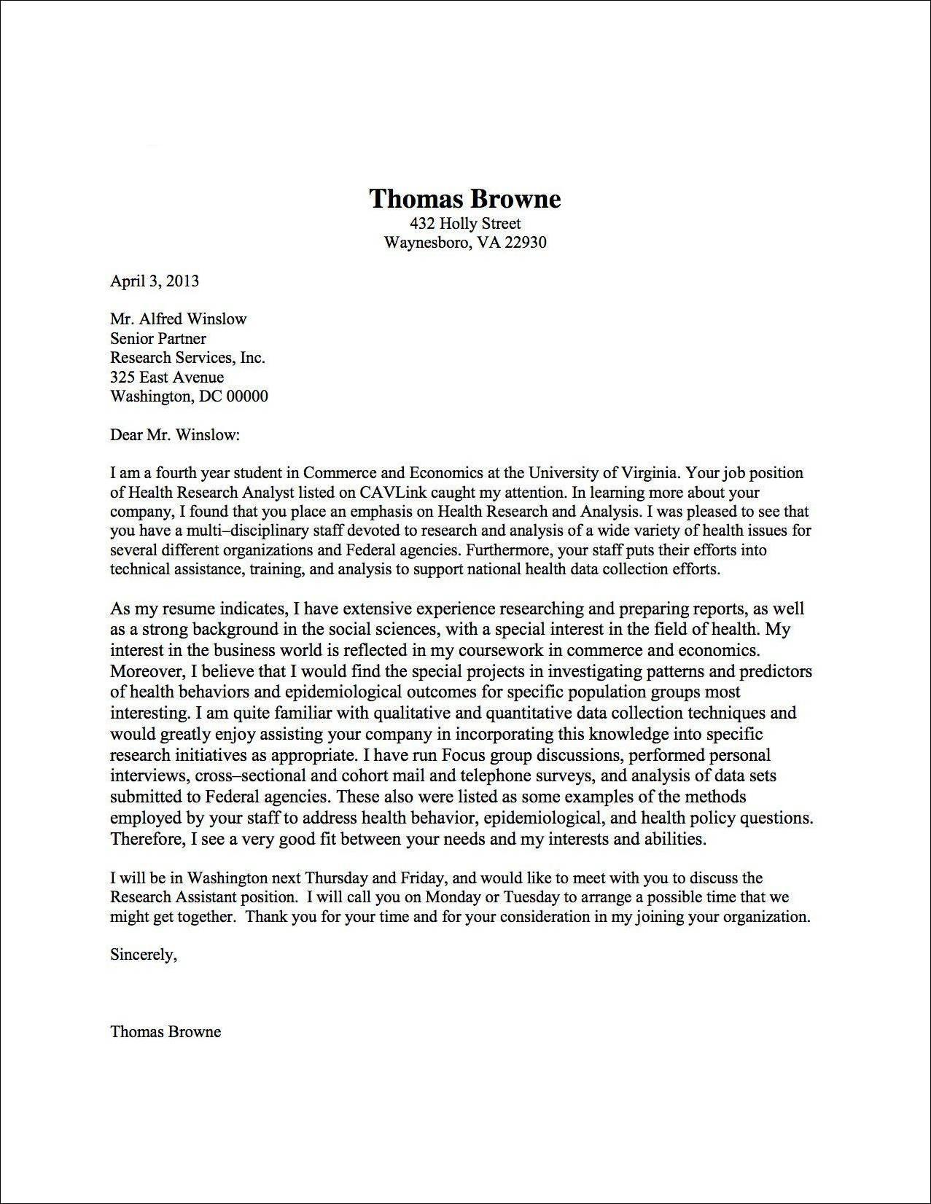
Cover letter format
Your address
The date
Employer’s name and address
Salutation
Introductory paragraph
1-3 body paragraphs
Concluding paragraph
Closing
Notes:
Since students don’t need to write a cover letter for the job fair, you could go through this section pretty quickly
Here’s an example with notes:
https://ucs.byu.edu/sites/default/files/handouts/KylieBarnesCL.pdf

Slide 40

Cover Letter * STAR = You, telling your story
Another tip: use STAR in your cover letter
The résumé lists numerous, specific experiences and accomplishments; the cover letter should highlight a couple of qualities or characteristics.
Start each body paragraph with a claim that connects your experience to the expectations of the position for which you’re applying (e.g., “Through years of being a math tutor, I have become adept at communicating math concepts clearly.”).
Then tell a brief STAR story to back up your claim.
Notes:
Why STAR? This is a great way to make yourself more “real” to employers
Instructor: Bring a prepared example from your own cover letter which contains a STAR story (this example will be important) – where is the STAR story? Is this effective? Could you replicate this?
STAR:
Situation
Task
Action
Result
See the following 2 slides for examples

Slide 41
STAR Example
“From my student teaching experience, I learned the advantage of immersing students in the language. Even though I taught a beginner level class, I spoke only Spanish and made the material comprehensible by using pictures, posters, drawing on the board, acting out, modeling, and using many cognates. For the health unit we compared culturally acceptable practices in South America and the United States. We created posters promoting certain practices and displayed them around the school. In groups we filmed Myth Busters shows with some of the practices we learned about. After three weeks in the classroom, the students were highly engaged, and understood significantly more Spanish.”
Notes:
This is a body paragraph from a student’s cover letter for a Spanish teaching position. You could read it aloud, or share your own example and skip this one.

Slide 42
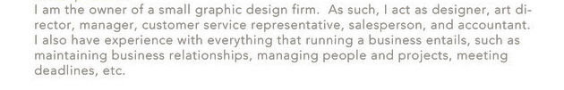
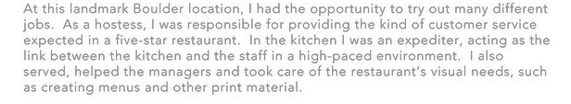
Examples—shorter stories
Notes:
Ask: Can you find the stories in these examples? What were the situation, task, action, and result?
Source: https://www.flickr.com/photos/enigmachck/3436023572

Slide 43
Activity
Look at your résumé and find your most recent job
Think of how you could make a STAR story from that job
What was the situation and problem that you solved? Action, results?
Now, write a STAR story that is:
Informative
Succinct
Compelling
Trade what you wrote with your neighbor, and give each other feedback about the stories (what was good, what you might try differently, etc.)
Notes:
Timing:
30 seconds
1 minute
3 minutes
3 minutes

Slide 44
Reflect
Do you see value in using STAR in a cover letter?
Take-away: consider using STAR stories in your cover letter for added depth, real-world application, and connectivity
Notes:
Depending on time, ask, “Any good examples of STAR stories you’d like to share?”

Slide 45
Take-away
Your résumé is your first line of interest, and where your future career starts
One of the instructional designers of this ACME course (Jacob) was once asked to interview for a job because he made mention of some accomplishments (i.e., STAR stories) from his days as a bee farmer. The interviewer was so intrigued, Jacob got an immediate interview!
One last note: Don’t sell your experience short. Focus on what you have, not on what you don’t have. It could be the difference between being “just one more résumé”, and being “that guy with the great story”

Slide 46
Assignment
Strengthen your résumé. Period. (This is left decidedly unspecific and vague. Do as much as you think needs to be done – in the end, you will be the one sending it to prospective employers). You will self-grade your work in this assignment.
Also: when you do visit the STEM fair, bring 3-5 copies of your latest résumé with you. A polished, up-to-date résumé could help you land the job.

Slide 47
Résumé Resources
There are many paid sites
One example: https://www.resumeedge.com/
A couple free options (résumés and cover letters)
http://www.girafferesume.com/
https://www.myperfectresume.com/
University resources (career center, writing center)
They’re ALWAYS happy to help people with résumés and the like
Talk to your dad, mom, or another close business professional
Odds are, they’ve prepared quite a few résumés; have them look yours over.
Notes:
More resources listed at the end of the lesson

Slide 48
Interviewing
Notes:
Interviews (slides 48-56): about 10 minutes
Wrap-up (slides 57-61): 1-2 minutes

Slide 49

Funny catch
Notes:
May take 30 seconds to load. It may help to go to the next slide, then come back.
“If you’re going to fail an interview, do it like Robin Williams.”
https://www.youtube.com/watch?v=fv34DbeXDek

Slide 50

The interview
If you’ve made it this far, you’ve likely:
Shown your interviewers something they’re intrigued in
Shared a copy of your résumé
Made a good first impression
Now, it’s time to seal the deal!
Notes:
Image from stock.tookapic.com

Slide 51
Question
What are some of the hardest interviewing questions out there?
If a blue plane flying south by southeast takes off from Chicago at 5am, what will the weather be like in Paris – provided the baguettes are fresh?
Estimate the daily cost of all the advertising made on all Google-owned sites.
Settle the Riemann Hypothesis.
Actually, almost universally, the question rated (Forbes, Monster, Careercast, INC, Business Insider, etc.) the most difficult to answer is: “Tell me about yourself.”
Really?! Why do you think?
Notes:
Sources:
DARPA Math Challenge Nineteen (http://www.math.utk.edu/~vasili/refs/darpa07.MathChallenges.html)
http://www.forbes.com/pictures/eglj45jhe/why-should-i-hire-you/
http://hiring.monster.com/hr/hr-best-practices/small-business/conducting-an-interview/toughest-interview-questions.aspx
http://www.businessinsider.com/hard-interview-questions-2016-2-25
http://www.careercast.com/career-news/10-toughest-interview-questions-%E2%80%93-and-how-answer-them
http://www.inc.com/jt-odonnell/7-intense-interview-questions-you-need-to-answer-correctly.html

Slide 52
Interviewing & STAR
Fortunately, STAR is specifically made for interviewing – sharing stories about what you’ve done best in your life
Yes, we’ve sufficiently beaten the ever-loving snot out of this dead horse: STAR. That said, it’s extremely useful, one that you will use in every interview for the rest of your life.
We’ve prepared very thoroughly for this next activity; let’s jump straight in!
Notes:
Image from pixabay.com

Slide 53
Activity: “Tell me about yourself.”
Write a few bullet points to answer the question
Ask this question to a classmate
Provide feedback (+-)
Switch
Remember: As you answer this question, use STAR to talk about specific Situations, Tasks, Actions, Results
Notes:
Take 1-2 minutes to write down a few bullet points to answer the question: “Tell me about yourself.”
What do you want the interviewer to know? What do you think they might want to know about you that they can’t tell from your résumé? What might surprise them? What would make them excited to have you?
Ask this question to a classmate and listen to their answer; then provide feedback (what they did well; what they can improve), and switch. Remember: use STAR to talk about specific Situations, Tasks, Actions, Results as you answer this question
(5-8 minutes)
Image from pixabay.com

Slide 54

Reflect
What value do you see in being able to answer this question?
How could you further strengthen your interviewing skills?
Notes:
Image from commons.wikimedia.org

Slide 55
It takes work
Self-rate: on a scale of 1-10 (1 = terrible; 10 = incredible), how good are you at talking about yourself – your strengths, successes, etc.?
If you fall into the “not so good” category, consider this:
Developing strong interviewing abilities doesn’t come naturally for everyone
Some people are naturally good at talking about themselves; others are not.
Hard work pays off—the best way to improve is to practice.
Notes:
(full script):
Self-rate: on a scale of 1-10 (1 – terrible; 10 – incredible), how good are you at talking about yourself – your strengths, past times you succeeded, etc.? (give students a few seconds to self-rate)
If you fall into the “not so good” category, consider this:
Developing strong interviewing abilities doesn’t come naturally for everyone
Some people are naturally good at talking about themselves; others are not.
Hard work pays off
-There’s no better way to say this. If you want to improve your interviewing skills, get out there and interview with a bunch of people. Your skills will improve. If you want a slightly more risk-averse way to improve, practice with your friends/family (see HW).
-The harder you work at improving your interviewing skills, the more likely you will be considered for a job – sometimes, even if you’re not as “skilled” as your fellow applicants.

Slide 56
Take-away
Your résumé gets you in the door; the interview gets you the job.
Being able to talk about yourself effectively in an interview can be the difference between “lots of potential” and having a salary.
Working on your interviewing skills is a great investment, especially if it doesn’t come naturally for you.

Slide 57
Assignment
Complete the following before next class:
Answer the question “Tell me about yourself” to 3-5 different people from different areas of your life (family, friends, roommates, colleagues, etc.)
(Optional) Receive and implement feedback from them

Slide 58
Review
Objectives:
Discuss the value of résumés & cover letters in selling your skills (HW)
Apply STAR principles in your cover letter
Practice initiating networking conversations
Notes:
Review the learning outcomes and ask if there are any questions

Slide 59
Additional Resources
http://career.virginia.edu/resumes
https://owl.english.purdue.edu/owl/resource/642/01/
https://ucs.byu.edu/resumes
https://ucs.byu.edu/cover-letters
Notes:
These resources have information and examples for effective cover letters and resumes

Slide 60
Additional Resources
Sources:
http://www.forbes.com/pictures/eglj45jhe/why-should-i-hire-you/
http://hiring.monster.com/hr/hr-best-practices/small-business/conducting-an-interview/toughest-interview-questions.aspx
http://www.businessinsider.com/hard-interview-questions-2016-2-25
http://www.careercast.com/career-news/10-toughest-interview-questions-%E2%80%93-and-how-answer-them
http://www.inc.com/jt-odonnell/7-intense-interview-questions-you-need-to-answer-correctly.html
Notes:
These resources have information and examples for effective cover letters and resumes

Slide 61

Content (not images or videos) copyright information:

